Slide 1

AstroSage Call Center Operations Analysis
Optimizing ₹1 Crore Investment Using Microsoft Excel
Presented By
Deeksha B K
Computer Science Engineering
Newton School Project
May 2026

Slide 2
Project Workflow
01
Problem Statement
02
Overview
analyzing historical call data, performance metrics
analyses the call center operations of AstroSage
03
Charts
04
Data Analysis
Charts and key Insights
Call volume, revenue, customer satisfaction and guru performance analysis
05
Key Insights
06
Dashboard
Key findings from call volume, revenue, satisfaction and repeat caller analysis
Built KPI cards, charts, Pivot Tables and interactive slicer
07
Strategic Recommendations
08
Conclusion
₹1 Crore investment plan across 6 priority areas
Interactive Excel dashboard, functions used, key takeaways

Slide 3
Problem Statement
Problem Statement
You are tasked with optimizing the call center operations for AstroSage, which has received a 1 crore investment. The goal is to determine how to allocate this investment to maximize operational efficiency, customer satisfaction, and profitability. This project will involve analyzing historical call data, performance metrics, and market trends to make informed decisions.
Project Goal & Scope
This project analyses 34 days of operational data (December 1, 2023 – January 3, 2024), covering 28,027 call records. The objective is to deliver a 360° view of call centre operations — addressing call volume trends, revenue performance, agent workload, and customer satisfaction — through an interactive Excel dashboard with slicers for real-time filtering.

Slide 4
Overview
Analyzed AstroSage's call center operations (Dec 2023 – Jan 2024).
Dataset includes 28,027 consultations, 131 astrologers, and 10,344 users across Gurucool and the App.
Performed analysis on cleaned and feature-engineered data with 36 attributes.
Evaluated call center performance, user engagement, and operational efficiency.
Identified operational bottlenecks, performance gaps, and revenue opportunities to improve guru utilization, customer satisfaction, and platform revenue.

Slide 5
Daily Call Volume Trend
Key Findings
Peak call volume reached 1,324 calls on 15 Dec 2023, well above the daily average of 824 calls.
Daily call volume showed high fluctuations with frequent spikes and drops.
Despite fluctuations, most days recorded 800–1,100 calls, indicating consistent user demand

Slide 6
Average Customer Satisfaction Score by Month
December recorded a higher average satisfaction score (2.95/8) than January (2.68/8).
Satisfaction declined by ~9% from December to January.
Despite 17% more consultations in December, it maintained better satisfaction, indicating that higher volume did not reduce service quality.
Key Findings

Slide 7
Hourly Call Volume Analysis
8:00 AM recorded the highest call volume (1,875 calls), with consistently high demand from 8 AM–4 PM.
Call volume declined sharply after 6 PM, dropping below 500 calls by 9 PM.
Overnight hours (12–2 AM) recorded the lowest call volumes, highlighting an opportunity to optimize staffing during off-peak hours..
Key Findings

Slide 8
Top 10 Gurus
Top 3 gurus (Astro Krishaa, Astro Sakthi, and Astro Shalini) handled 15.5% of total consultations, indicating workload concentration.
Consultation volume and revenue are not directly correlated.
Astro Ruchi delivered the best overall performance with 777 consultations, the highest rating (4.44/8), and ₹19,993 revenue.
Key Findings

Slide 9
Call Status Distribution
Only 40.4% of calls were successfully completed.
No-answer (20.2%) and busy (14.9%) were the top reasons for failed calls.
5,088 missed calls indicate a strong opportunity to improve revenue through callbacks and better guru availability.
Key Findings

Slide 10
Customer Rating Distribution
Key Findings
Rating 0 (25.9%) was the most common customer rating.
The high number of 0 ratings likely indicates unrated sessions, not poor service.
First-time users reported higher satisfaction than repeat users, highlighting a decline in user experience over time.

Slide 11
Website Distribution
Key Findings
Gurucool accounted for 72.2% of sessions and 78.1% of total revenue.
Both platforms recorded similar customer satisfaction (Gurucool 2.92 vs App 2.98).
The App has monetization potential, indicating opportunities to increase revenue.

Slide 12
Revenue by Consultation Type
Calls generated 78.7% of total revenue, despite accounting for only 30.4% of sessions.
Chats made up 69.6% of sessions but contributed only 21.3% of revenue.
Converting more chat users to calls can significantly increase platform revenue.
Key Findings

Slide 13
Rating-wise Guru Distribution
Key Findings
35.4% of gurus fall within the 3–4 rating range.
Only 6.9% of gurus have ratings above 5, highlighting quality variation.
Astro Pujaa Rai and Tarot Mystical are the top-rated gurus (7.5/8).

Slide 14
Key Insights
December contributed 94.5% of total consultation sessions. Voice calls generated 78.7% of revenue despite representing only 30.4% of sessions.
81.2% of sessions came from repeat users, indicating strong customer retention. Average customer satisfaction was 2.93/8, with 25.9% of sessions receiving a 0 rating. Call duration had no significant impact on customer satisfaction (r ≈ -0.003).
Top 3 gurus handled 15.5% of all consultations, indicating workload concentration. Only 40.4% of call attempts were completed, highlighting opportunities to improve call success and revenue.

Slide 15
Expected Outcomes — 12-Month Targets Post-Investment
Improved Customer Satisfaction
Better Workload Distribution
Reduced Agent Burnout
Enhanced Peak Call Handling
Stronger Customer Retention
Increased Operational Efficiency
Better Agent Performance Monitoring
Improved Resource Utilization
Higher Revenue Potential
Data-Driven Decision Making
Long-Term Business Growth
Investment in training, technology, and workforce planning is expected to improve efficiency, customer satisfaction, and profitability.

Slide 16
Excel Dashboard & Tools Used
Dashboard Components
Excel Tools & Functions
KPI Area
Section
Visual Type
Pivot Tables & Pivot Charts
KPI Cards (linked to Pivot data)
Total Calls, Daily/Monthly Volume
Call Volume
Line Chart + KPI Cards
Slicers — Country, Year, Month
Avg Rating — overall, by month, by guru
Satisfaction
Bar Chart + KPI Cards
SUM() — Revenue analysis
CORREL() — correlation analysis
Calls per agent, Top/Bottom 5 gurus
Agent Performance
Clustered Bar Chart
MAX() / MIN() — Peak call volume
Unique Callers, Repeat Caller Rate
Caller Behaviour
KPI Cards
IF / ISBLANK / UPPER / TRIM
INT() — date extraction from timestamps
Astrologer Earnings, Operational Cost
Operations Cost
Column Chart + KPI
UNIQUE() — duplicate detection check
Year, Month, Website, Consultation TypeSlicers
Filters
Interactive Slicers
Conditional Formatting on KPIs
Chart formatting with custom colours
Dynamic slicer-linked dashboard

Slide 17
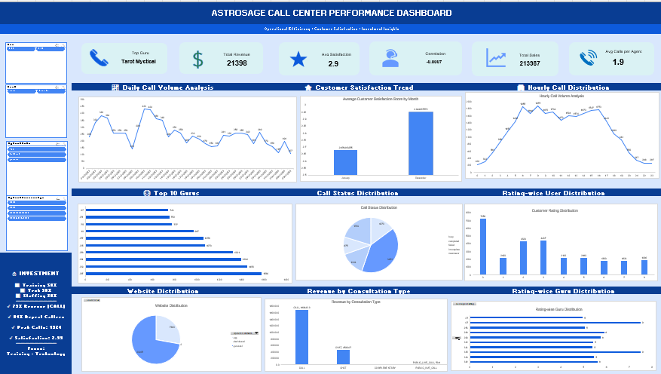
Excel Dashboard

Slide 18
Strategic Recommendations
Improve call completion through callback scheduling and real-time guru availability.
Encourage chat-to-call conversion to increase revenue.
Differentiate unrated sessions from genuine zero ratings for accurate satisfaction analysis.
Train and monitor low-rated gurus while promoting high-performing gurus.
Optimize guru availability during peak hours (6–10 AM).
Grow the App through targeted promotions and exclusive features.
Rebalance guru workloads and introduce performance-based incentives.

Slide 19
Conclusion
Analyzed the AstroSage call center dataset using Microsoft Excel.
Performed data cleaning, feature engineering, and interactive dashboard development.
Evaluated call volume, revenue, customer satisfaction, and guru performance using PivotTables and charts.
Identified key insights, including higher December call volume, voice calls as the primary revenue driver, and strong contribution from repeat users.
Proposed data-driven recommendations to improve service quality, operational efficiency, customer satisfaction, and revenue growth..

Slide 20
Thank You

